Slide 1
K fold
………………

Slide 2
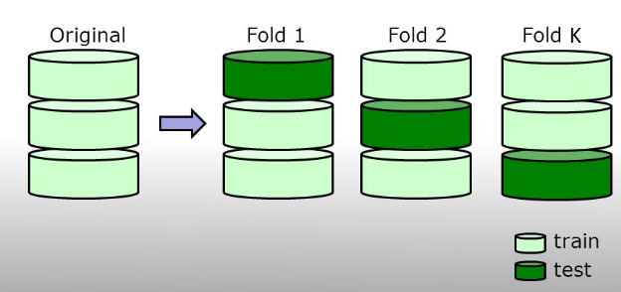
What is k fold?

Slide 3
…
For data division we implemented the k- fold validation methodology. Data is divided into k equal partitions (also called ‘folds’). Experiments (training a model and then testing it) are conducted k times. In each experiment, one fold is retained for testing and classifier model is trained on the remaining folds. Accuracy and other evaluation metrics are averaged over all folds to give the overall result of the classifier’s performance. K fold ensures that the results are not biased due to a random good or bad data division.

Slide 4
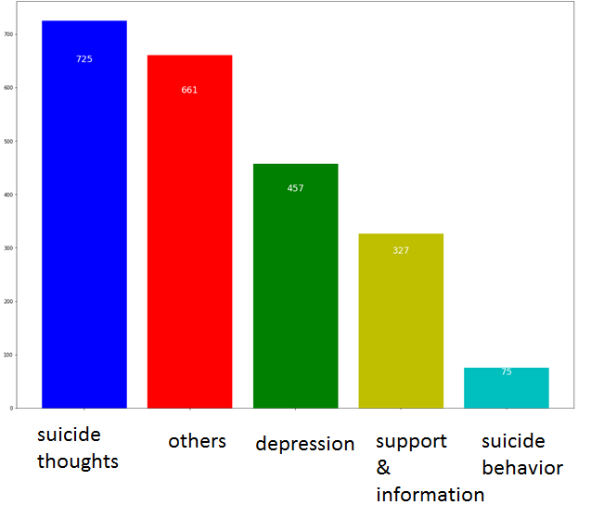
What if your data is highly unbalanced?
We have a data of tweets of different topics.

Slide 5
Downside of simple k fold
For cases such as this where data distribution is highly uneven, k fold due to its random sampling might miss entire samples of some category (with lower representation) in some of its training folds- thus seriously hampering results.
This is the reason we chose stratified k fold in our experiments. It is a variation of k fold where it is ensured that class distribution of our whole data is retained in each train and test fold.

Slide 6
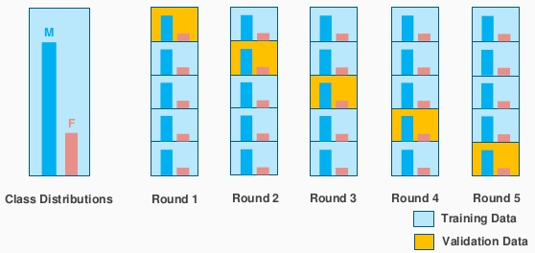
Stratified k fold

Slide 7
…
Stratified: The splitting of data into folds may be governed by criteria such as ensuring that each fold has the same proportion of observations with a given categorical value, such as the class outcome value. This is called stratified cross-validation.

Slide 8
Grid search
Remember?

Slide 9
…
GridSearchCV is a way of systematically working through multiple combinations of parameter tunes, cross-validating as it goes to determine which tune gives the best performance. The beauty is that it can work through many combinations in only a couple extra lines of code.

Slide 10
…
parameters = {'kernel':('linear', 'rbf'), 'C':[1, 10]}
svm = svm.SVC()
clf = grid_search.GridSearchCV(svm, parameters)
clf.fit(iris.data, iris.target)
clf.best_params_

Slide 11
…
parameters = {'kernel':('linear', 'rbf'), 'C':[1, 10]}
A dictionary of the parameters, and the possible values they may take. In this case, they're playing around with the kernel (possible choices are 'linear' and 'rbf'), and C (possible choices are 1 and 10).

Slide 12
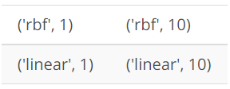
…
Then a 'grid' of all the following combinations of values for (kernel, C) are automatically generated. Each is used to train an SVM, and the performance is then assessed using cross-validation.

Slide 13
…
svr = svm.SVC()
This looks kind of like creating a classifier, just like we've been doing since the first lesson. But note that the "clf" isn't made until the next line--this is just saying what kind of algorithm to use. Another way to think about this is that the "classifier" isn't just the algorithm in this case, it's algorithm plus parameter values. Note that there's no monkeying around with the kernel or C; all that is handled in the next line.

Slide 14
…
clf = grid_search.GridSearchCV(svr, parameters)
This is where the first bit of magic happens; the classifier is being created. We pass the algorithm (svr) and the dictionary of parameters to try (parameters) and it generates a grid of parameter combinations to try

Slide 15
…
clf.fit(iris.data, iris.target)
And the second bit of magic. The fit function now tries all the parameter combinations, and returns a fitted classifier that's automatically tuned to the optimal parameter combination. You can now access the parameter values via clf.best_params_.

Slide 16
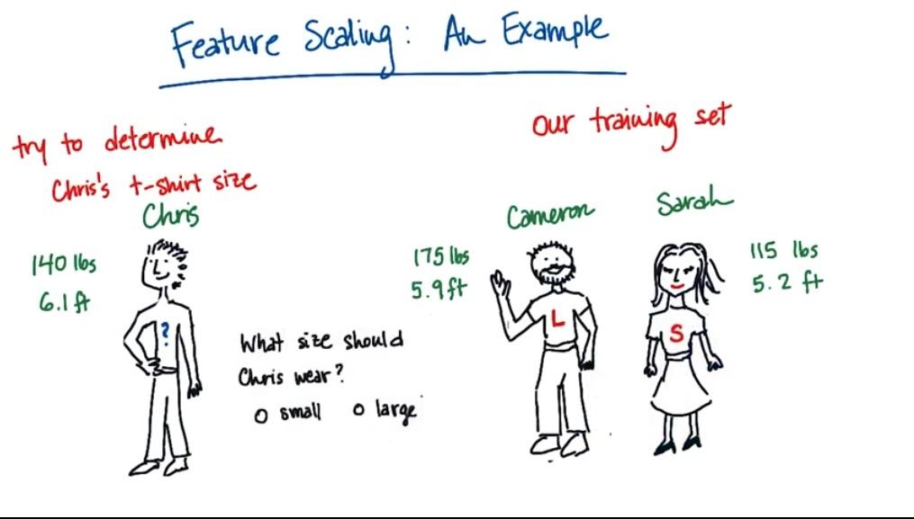

Slide 17
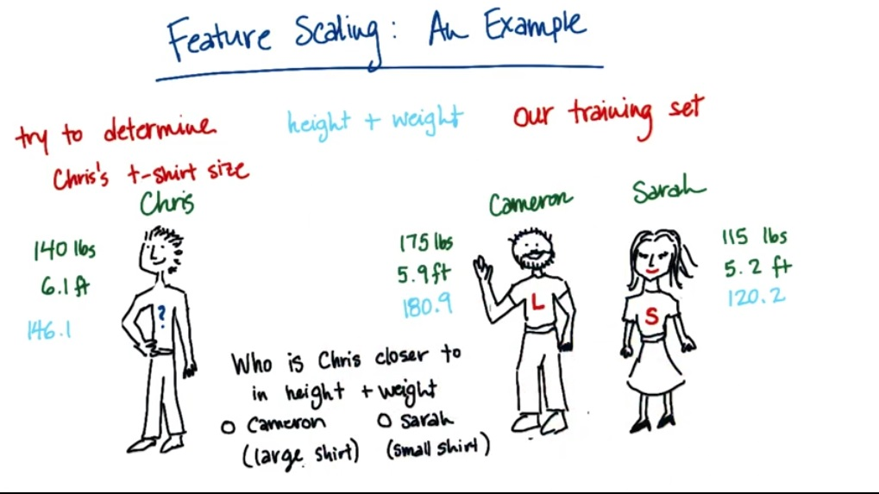

Slide 18
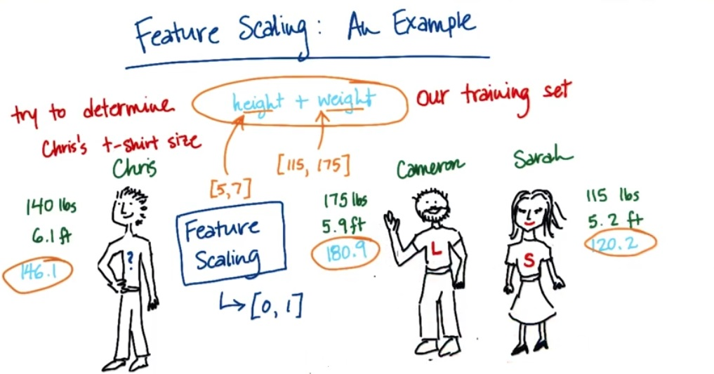

Slide 19
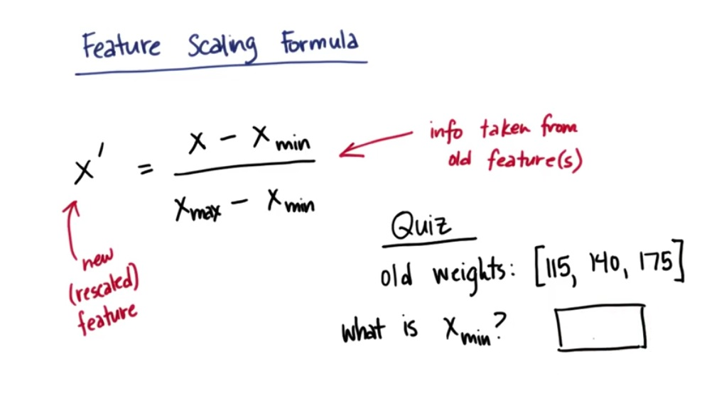

Slide 20
Probability

Slide 21
Conditional Probability
P(A|B)

Slide 22
Joint Probability
P(A,B)

